Slide 1
CHILD CARE PROGRAM COMPARISON

Slide 2
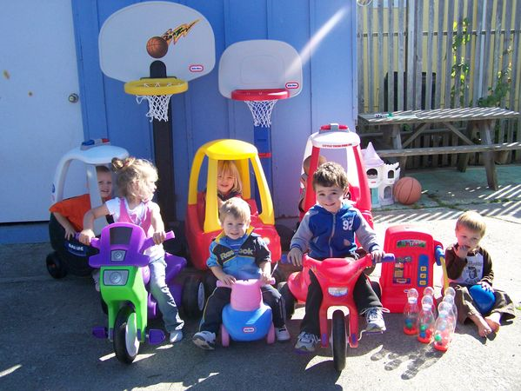
PROS & CONS OF DAY CARE
PROS
CONS

Slide 3
TYPES OF CHILD CARE:
CUSTODIAL: Care for basic needs (physical, Health, & Safety)
Examples:
home care
hourly care
or daycare

Slide 4
TYPES OF CHILD CARE:
DEVELOPMENTAL: Provides Cognitive (Intellectual) development
Social, emotional, physical, & moral development of the child. Curriculum Based.
Examples: Montessori, preschool, etc.

Slide 5
TYPES OF CHILD CARE:
COMPREHENSIVE: Combines both custodial and developmental care
May include additional services such as:
Dental, medical and social services, etc
Examples are: Lab schools, Head start, child care, on-site child care, etc.

Slide 6
HOURLY CARE:
Care that is open before, during, and after business hours to meet various working parent’s schedules
Pro: Could be less expensive in the end because you do not pay for the child when they are not receiving care

Slide 7
HOURLY CARE:
Cons: Prices can be high for the care
Difficult to find a reputable place
Flexibility: Care works around your
Schedule.
High ability to negotiate personal care and routines.

Slide 8
MONTESSORI SCHOOLS
DESCRIPTION: Focus is Learning by doing, hands on, and exploring material to guide their own education.
Pro: Freedom of movement. Student choice activity
uninterrupted 3 hour blocks of work time. Students learn concepts from working with materials
A trained Montessori teacher is present.
Teachers need at least 2 years of training.

Slide 9
MONTESSORI SCHOOLS
Con: Low teacher interaction. Little amounts of free time to just play. Self-paced and individual work with Limited opportunities for peer collaboration.
Transition into a regular teacher-driven classroom setting is more challenging.
Flexibility: Child attends only when class is in session. They follow a strict schedule.

Slide 10
HEAD START
DESCRIPTION: Gov. structured and funded child care program promoting school readiness and success for children in low-income families by providing comprehensive educational, health, nutritional, and social services.
Not just a daycare center, but a provider of high quality child care & Early Childhood education where learning is child’s play. (preschool)

Slide 11
HEAD START
Pro’S: Helps low income children to enter kindergarten at a higher level.
Provides a stable environment
Meals, shots, health care, professional staff, gov. funded, transportation, counseling provided.

Slide 12
HEAD START
Con’S: Funding instability
Segregated by economic status as it only targets and benefits the poor and lower income families.
Children may have emotional problems from being surrounded by other children with emotional issues related to the socioeconomics.
Flexibility: Less ability to negotiate care & routines.

Slide 13
Preschool
description: an early childhood program in which children, ages 3-5, receive kindergarten readiness skills. Enrollment is for a half day or less
Pro: Encourages intellectual development mixed with play.
Promotes & strengthens emotional & social skills

Slide 14
Preschool
Pros continued:
Pro: Encourages intellectual development mixed with play.
Promotes & strengthens emotional & social skills
grouped with other Children their age
Small classes

Slide 15
Preschool
Con’s: high cost
Short instructional time so not day care.
Teacher may not be A trained ec INSTRUCTOR.
Facility may not be a state licensed or quality site.
High teacher to child ratios

Slide 16
Preschool
flexibility:
Low because your child only attends when your class is in session.
More of an opportunity to negotiate care and routine.

Slide 17
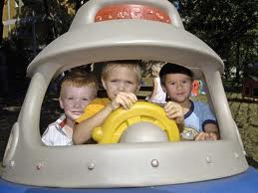
ON-SITE DAY CARE
DESCRIPTION: child care is located at the place of the parents’ employment.
Pro’S: parents can work near child & drop in during the day, company shows that they support families, reduces lateness & stress
conS: Child may have a longer drive with parent’s commute, costly for company, parents may visit too often
Flexibility: is available during working hours

Slide 18
HOME CARE
DESCRIPTION: child care provided in a person’s home or one that comes to your home. Often maintains a daycare philosophy.
proS: least expensive type of care. Provides low teacher to child ratio care. Homelike atmosphere.

Slide 19
HOME CARE
conS: Not structured, they can go about their daily routines, and not have total focus on your child.
difficult to enforce licensing and credentials of caregiver.
If provider is sick, the parent must find another place for care
Takes in birth to 12, so they may not have other children their age.

Slide 20
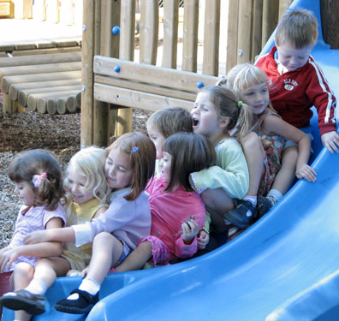
DAY CARE CENTERS
DESCRIPTION: 13 or more children ages 4 weeks to 13 years. License required. Informal play
ADVANTAGES: multiple adults watching and Caring for basic needs of child, they have concern for the child only.
DISADVANTAGES: Crowded and commercialized. Ratios of children to teacher is high.
flexibility: adhere to specific closing time

Slide 21
NURSERY SCHOOL
DESCRIPTION: Kindergarten prep, intellectual development
pros: Developmentally planned program for overall growth
conS: High cost ($90-140/month)

Slide 22
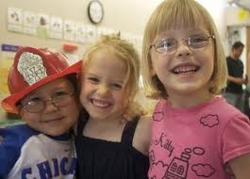
LAB SCHOOLS
DESCRIPTION: student teachers learn & practice the art of teaching real children.
pro’S: low child to teacher Ratio, innovative & quality care center.
Con’S: It is a lab to train students. Constant turn around in staff so difficult to maintain consistency & routines.

