Slide 1
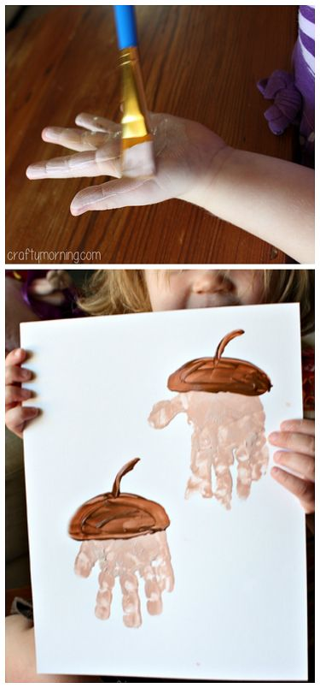
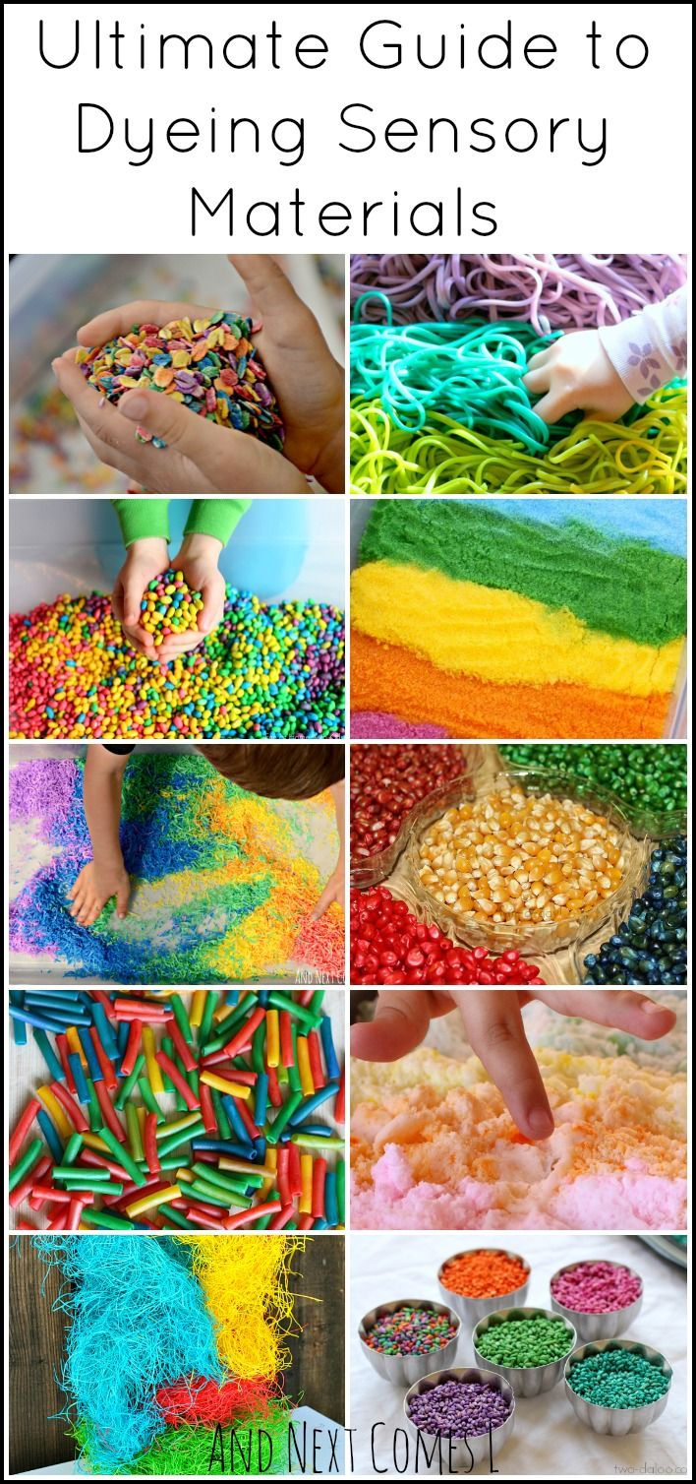
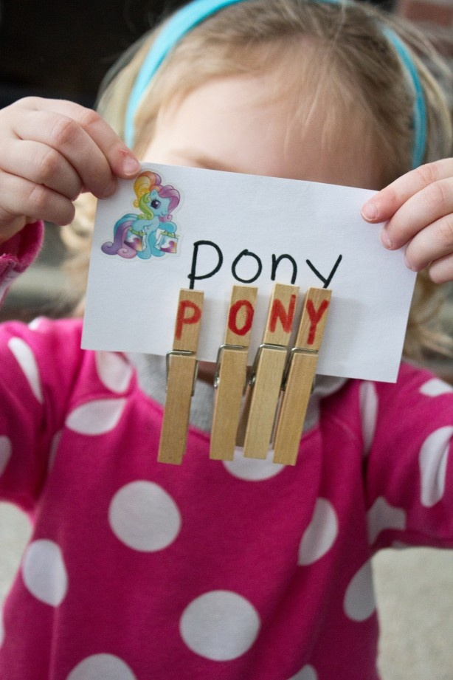
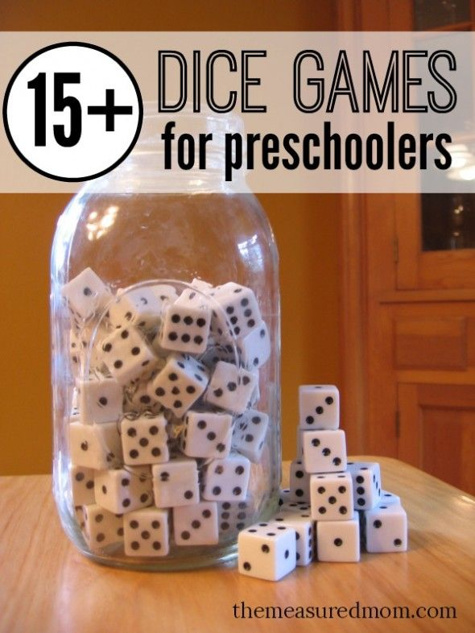
PLAY!

Slide 2
Play
Play is a child’s work it is the most important job they will do all day.
They learn about themselves, others, and their world that they live in.
Builds confidence and self-concept, initiative, and autonomy (independence) = Erikson’s theory
Releases energy
Develops the 5 basic areas of growth and development:
Physical
Emotional
Social
Cognitive
Moral

Slide 3
Areas of Play
Unoccupied behavior
Onlooker behavior
Solitary play
Parallel play
Associative play
Cooperative play

Slide 4
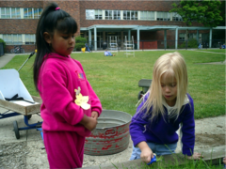
Unoccupied behavior
The child is not involved in any particular activity. He/she just observes what seems interesting at the time. When nothing of interest is happening, he/she will walk around, look around, or play with his/her fingers, hair, etc. The child often appears to be day dreaming.

Slide 5
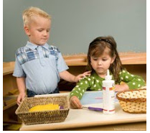
Onlooker behavior
This behavior involves watching other children play. The child may talk to the children who are playing but does not become actively involved. The onlooker wants to be close enough to interact with the children who are playing whereas the unoccupied child’s interest keeps shifting to anything that interests him/her at the moment. (begins in toddlers) Level 2 of this type of play is when children are watching others play and waiting for their turn as in the game “Duck, Duck, Goose”.

Slide 6
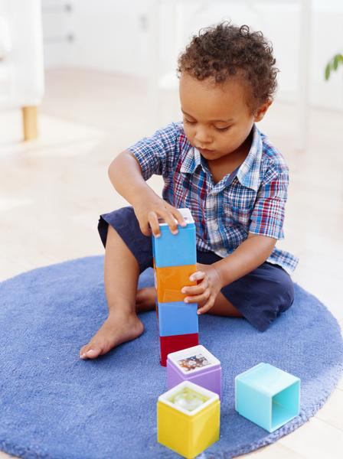
Solitary play
This type of play involves a child playing alone. He/she has no interest in anyone else or what they are doing. The toys he/she plays with are different from those the other children are playing with. He/she is totally involved in a personal activity. (begins in infants)

Slide 7
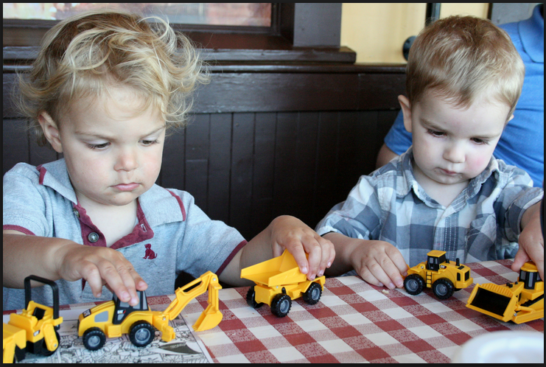
Parallel play
This type of play involves a child playing beside other children. There is no actual interaction, but the toys are similar. The child is playing beside the other children rather than with them. Toddlers often participate in parallel play because communication with one another is difficult. (begins 2-3 years)

Slide 8
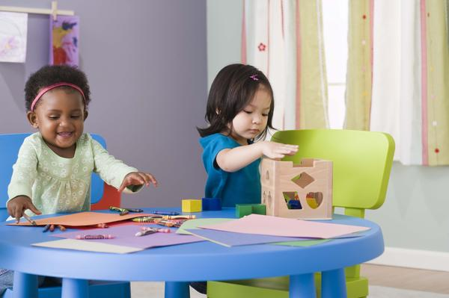
Associative play
This type of play involves a child playing with other children. The children share toys and interact with one another. Children are involved in similar but not identical activities. There is no specific organization of activities. Each child does what he/she wishes but is a part of a large group. (begins 3 year – school age)

Slide 9
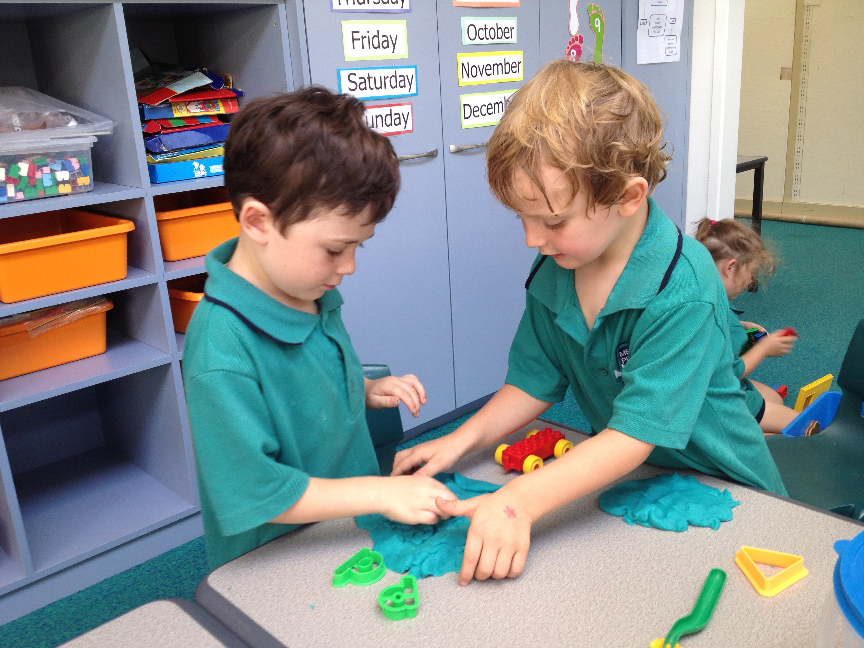
Cooperative play
This type of play involves organization. The child is a part of a group that has a specific purpose in mind such as making an art project or playing a game. There are usually leaders and followers in this type of play. (begins as preschoolers)

Slide 10
Free Play
Define
Examples
No instructions are needed just supplies
Allows child to act on own imagination and problem solve through the activity
Open ended toy or activity: the child decides when the activity is over
Closed ended toy or activity: the activity determines the end
Play dough
Magnets
Sand
A game
A puzzle
A book

Slide 11
Passive Play
Define
Examples
Having no interaction with others.
All children need this, but keep it limited.
Watching TV
Reading
Computer
Video games
Daydreaming
Musical instruments
Coloring

Slide 12
Sensory and Discovery Play
Define
Examples
Hands on learning
Using the senses to explore
Predictions
Observations
Compare and classify
Simple experiments
Sensory tables
Chemistry: suspension, chemical reaction, chemical change

Slide 13
More on Sensory and Discovery
Exciting discussions (build language skills and encourages curiosity)
Effective questioning (to encourage critical thinking skills and problem solving to make all of the above happen)

Slide 14
Fine/Small Motor and Manipulative
Define
Examples
Objects that provide tactile and hands on learning experiences
Manipulative – made of almost anything (blocks, shapes, etc…) that help student connect math to physical objects
Create pictures - self-portrait is typical
Sorting trays help organize such as: like clear cup, egg carton, muffin tin, ice cube tray
Drawing, using scissors, clay, puzzles, magnets, beads

Slide 15
More on Fine/Small Motor
Fine motor activities can meet all curriculum areas: math, art, music, language, science
Math concepts should be concrete, filled with play, exploration and use MANIPULATIVES.
Figuring the measurement of objects in length, height, weight, size
A variety of blocks in the block area helps children learn math concepts like sizes and shapes
Can draw shapes
Small motor skills create the ability to formulate language, write, draw, manipulate small objects and toys, accomplish self-help tasks or basic daily skills.
Builds cognitive skills thinking, reasoning, problem-solving, understanding

Slide 16
Gross/Large Motor, Active, Outdoor Play
Define
Examples
Larger movements that use the arms, legs, feet, or entire body
Works on larger muscles of the body
Count as we clap
Climb stairs
Jump up and down
Running
Bean bag toss
Tag
Playground play

Slide 17
More on Gross/Large Motor
Gross motor activities can meet all curriculum areas: math, art, music, language, and science
It is a release of energy and builds physical and social skills.
Included daily as part of the curriculum. Teaches healthy habits of activity
Provides a balance of rest and active play to regulate the child’s behavior.
In free play activities, no instructions are needed and it allows children to act upon their own imaginations using a variety of materials related to the theme.

Slide 18
Block Area
Define
Examples
Place away from quiet areas and next to noisy areas like dramatic play
Ample space to build without getting in the way of others
Use the shelves for separation, walls, and storage.
Use a flat carpeted surface for warmth, comfort, and noise control.
Provide props other than blocks: furniture, people, cars, animals, road signs…..

Slide 19
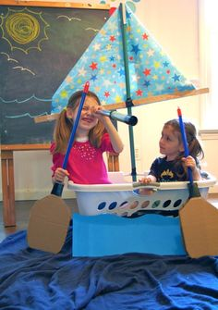
Dramatic Play
Define
Examples
Situations that teach real life experiences and allows a child to express themselves and their emotions.
Think of it as a stage where the child enters and immediately takes on a role.
Character role
Puppetry

Slide 20
Benefits of Dramatic Play
Provides an outlet for the child’s inner thoughts and feelings.
The self-conscious child can hide behind a puppet or a character and act out feelings or be anything. They may say things to or through a puppet that they would not say to anyone else.
Develops problem solving skills, cause and effect, decision making, autonomy, and self-image.
Practice language development, verbal expression, and social interaction. Plot development
Allows children to learn about and experience their world and the people in it. Teaches about occupations and roles and how to do them in real life.

Slide 21
Creating the Dramatic Play Area
It is often based on the theme
Separate area that can have 3 sides. Walls, dividers, shelves, and furniture can be used
Near other noisy areas. Near block area so they can share supplies
Ample space to build and develop, flat, and carpeted
Containing real life items and household junk items that are being put to good use
Provide Language and Literacy experiences through the props that are included ie: menu, cereal boxes, magazines, maps, paper and envelopes for the post office dramatic play space, etc…
Be aware of culture. Supply pictures and props that represent different races, and types of culture
Best done when restrictions are few and possibilities are endless
Trucks, hats, dolls, similar toys are examples of props found in the dramatic or free-play area.

Slide 22
How Parents Interfere with the value of play
Too many toys: Child has too many toys to play with which causes confusion, overwhelming, and too many choices.
Purpose and Timing of Toys: Parents are eager to provide toys for the child which they might be too young for, not interested in at the time, or it is not their type.
Toys for boys and Toys for girls: Child has been stereotyped and only has gender appropriate toys, games, and activities. Let them choose their own interests.
Self-conscious Play: Parents enter child’s play too actively or at the wrong time. They might laugh, ask a question, make suggestions, or criticize the child’s play.
Hinder Creativity: Parent’s not allowing kids to be kids and explore, experiment, play, get dirty, make mistakes, and expecting them to follow the protocol of how it is to be in the real adult world. This is a child’s world.
Competition: Parents make play a competition – win, be the best, do it first, make it right.

