Slide 1
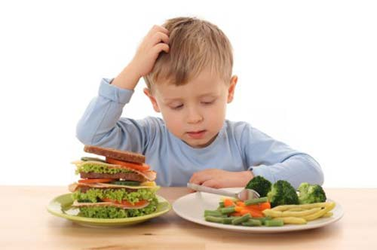
Nutritional Needs of Children
Standard 3 Objective 2

Slide 2
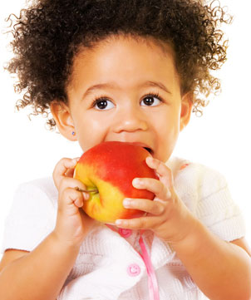
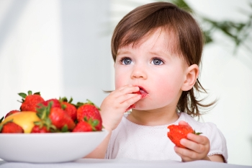
Purpose of snacks and meals
Snacks round out the child’s diet

Slide 3
Guidelines - snacks and meals
Limit the empty calories (no/low nutritional value, high in fats, sugars, and sodium)

Slide 4
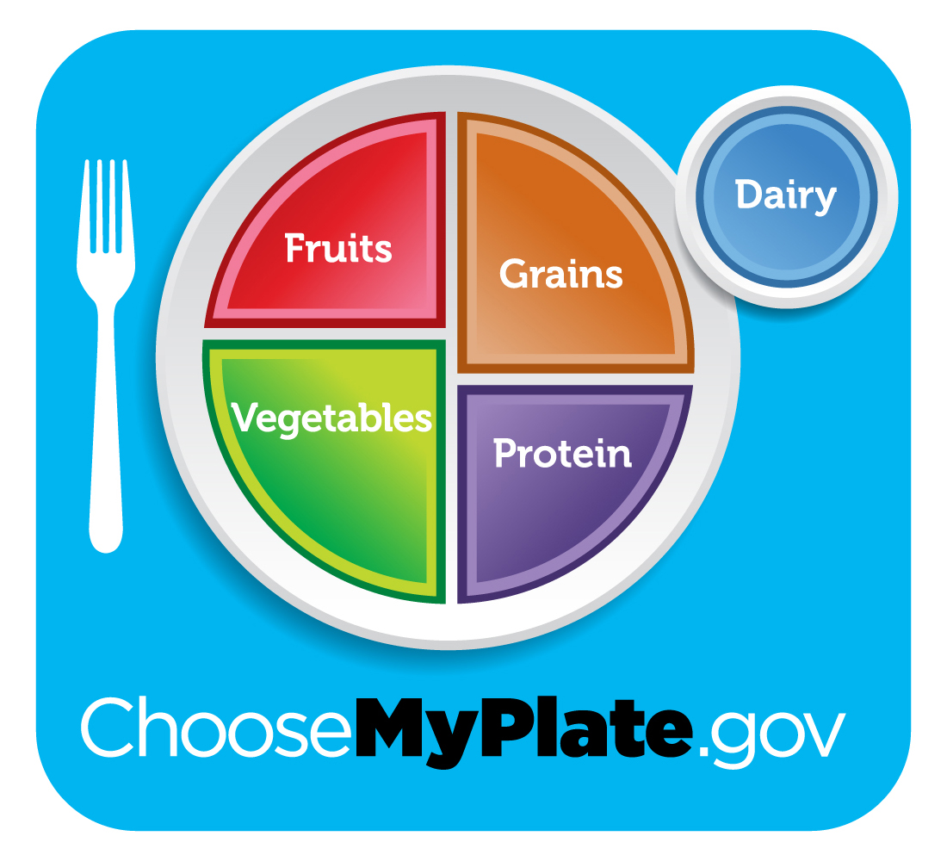
MyPlate
Use this as a model.

Slide 5
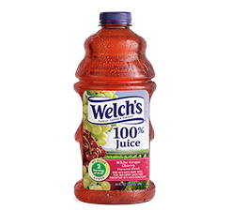
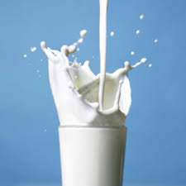
Guidelines - beverages
milk, water or 100% juice

Slide 6
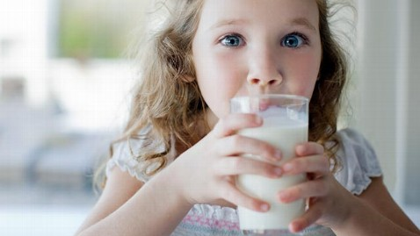
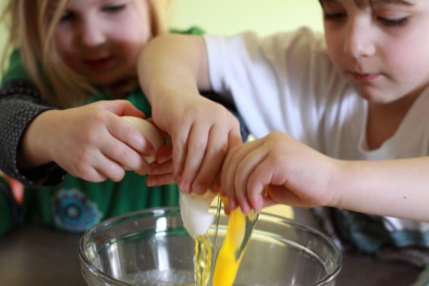
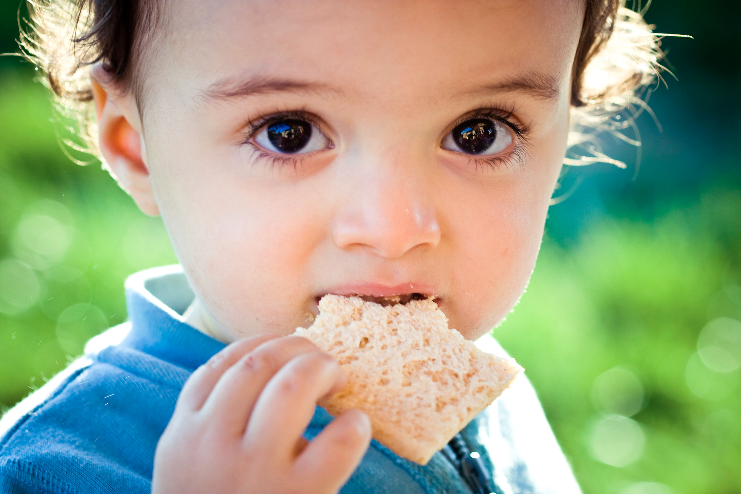
Food allergies
Common food allergies include:
milk, eggs, peanuts, wheat

Slide 7
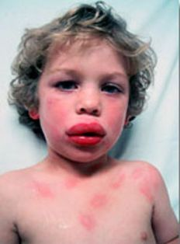
Prevention of allergies
Carefully monitor what they eat--Make sure you are aware.

Slide 8
Basic safety and food sanitation guidelines
Rubber gloves when handling food sick child, wiping down tables, or handling bodily fluids.
Personal Hygiene
Washing hands
Storing foods at proper temperature

