Slide 1
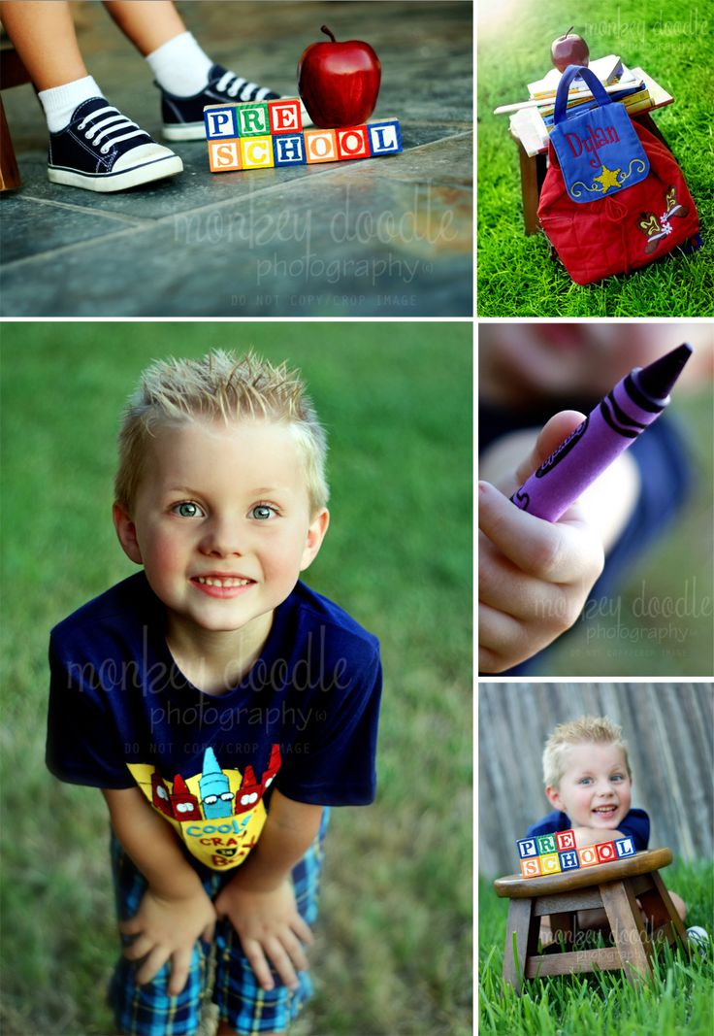
Developmentally Appropriate Practices (DAP)

Slide 2
1. DAP Characteristics
DAP Stands for: Developmentally Appropriate Practices | Uses all areas of development Physical, Emotional, Social, Cognitive, Moral | Children’s Choice Children are allowed to choose their own materials and plans for projects and activities
Age and Individual Appropriateness Of a child's needs and skills to prevent frustration | Real and Relevant Relate to their own surroundings, life, and experiences | Multicultural and Non-Sexist

Slide 3
1. DAP Characteristics
Scheduling and time: Is flexible to meet the needs of the child (give more time to finish) | Child-Directed Child-Initiated Teacher-Supported | Using all 5 senses to discover and experience
Hands on Learning and Concrete Learning by experience the concept, by participating, seeing, doing, touching, and manipulating | Learning and Progressing At the child’s own rate of development

Slide 4
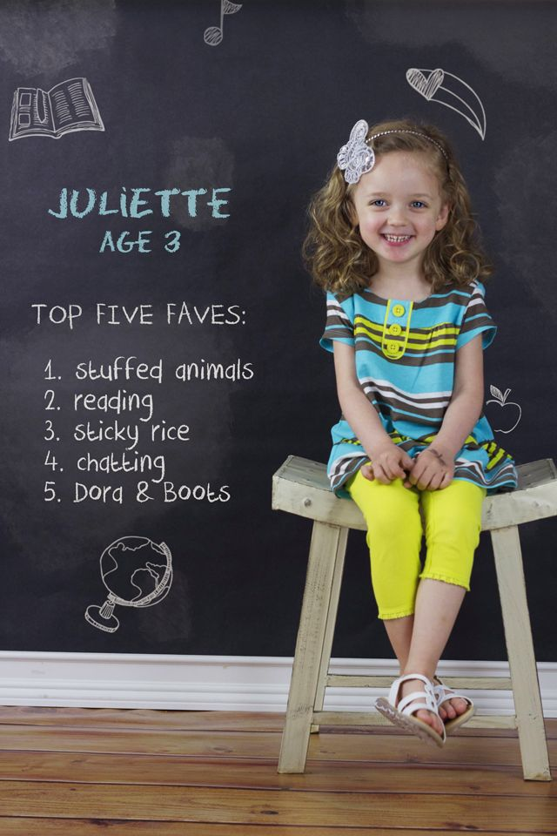
2. Types of Learning
Child-Directed Learning
Child decides what to do, the idea, and the materials to use.
Adult follows the child’s lead
Teacher-Directed Learning
Teacher decides what to do and how to do it
Precut and pre-drawn materials with instructions for what to do with them
Child-Initiated Learning
The child decides what to do and starts to do it on their own

Slide 5
3. Learning Styles
Visual Learners: A child who depends a great deal on the sense of sight. This child will notice small visual changes in the environment
Tactile Learners: A child who learns best through doing. This child needs to be shown and allowed to do it with you. Hands on.
Auditory Learners: A child who learns best through hearing. This child is the first to hear a fly in the classroom or a snow plow outdoors.

Slide 6
3. Learning Styles
Field-Sensitive Learners: Children who are more interactive with others; volunteering, assisting, and helpful, they also try to gain attention.
Field-Independent Learners: Children who are more independent and prefer to work on their own. They enjoy competition as well as individual recognition

Slide 7
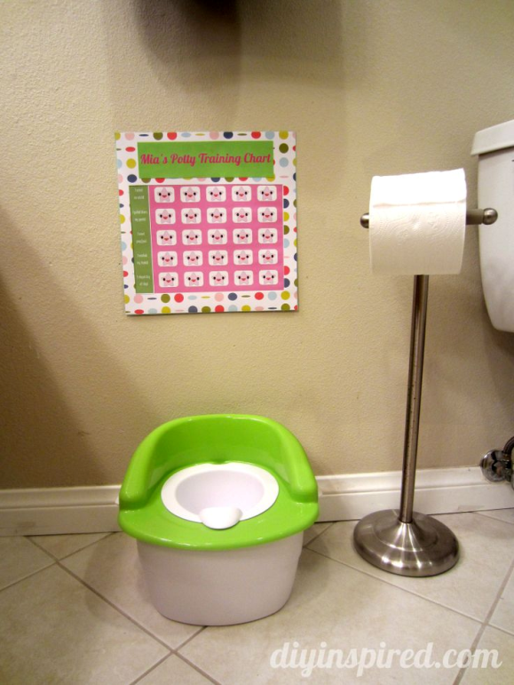
4. Application Question
Why is it that a child who is 3 years old is toilet trained, but another 3 year old child is not?
“Learning is a walk of discover not a race to the finish line”
Every child is develops at their own rate. It might take some longer than others to learn certain things.

Slide 8
5. ACTIVE vs. PASSIVE Learning
Active learning is being actively involved and engaged in the learning by doing, seeing, and thinking
Quiet learning is similar to active learning, but not as noisy or as much movement,
i.e. small learning centers or self-selected activities
Passive learning is sitting and listening without interaction with others, the instructor, or manipulative objects

Slide 9
5. ACTIVE vs. PASSIVE Learning
Repeating Activities = allows children to feel successful and self-confident
Problem Solving is:
Looking at the issue at hand
Brainstorming – ideas and possibilities
Experimenting and Testing
Taking Action
Deciding the best way to go about it

Slide 10
5. ACTIVE vs. PASSIVE Learning
Fearful Child = teacher should listen with patience and problem solve together
Why does a 3 year old say “WHY”?
To gain information and to learn about their world
Direct Learning – Learning that results form being taught (planned learning)
Indirect Learning – unplanned Learning

Slide 11
6. Effective Transitions
What is a transition??
Movement from one activity to another

Slide 12
6. Effective Transitions
4 Areas of Effective Transitions
Transition | Definition | Example
Concrete | Where children or objects move from one place to another | Hanging up coat, walking to rug
Visual Signs | Where signals are used that the child can see to inform them of a change in activity | Name tag yellow, follow yellow sign, all children holding purple flower go to art table

Slide 13
6. Effective Transitions
4 Areas of Effective Transitions
Transition | Definition | Example
Auditory Signals | Inform the children of change through the use of sound | Ring a bell/chime Whisper – “If you can hear me touch your nose” Clapping and chanting – “Her name is Jessica and how are you, who’s that sitting next to you?”
Novelty Signs | Involves the use of unusual or new actions and devices to move the children from one activity to the next | Magic wand, hope like a bunny, march, walk backwards, crawl, follow the leader

Slide 14
7. Questioning: Open-Ended Questioning
Open-Ended Questioning is asking the children a question that requires a response of more than a yes or no answer
Requires thinking and giving opinions and feelings
Asking questions that you DO NOT already know the answer to
Use the 5 W’s → who, what, where, when, why (so the child can answer with more than 1 word)
Examples:
Why do you think ice is cold?
What did you do this last weekend?

Slide 15
7. Questioning: Closed-Ended Questioning
Closed-Ended Questioning: questions that require only a yes or no response
Examples:
Is blue your favorite color?
Was it fun?

Slide 16
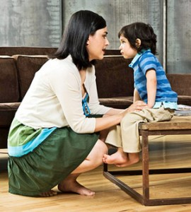
Whenever talking to a child, get on EYE LEVEL. Listen and respond using your FACE, VOICE, and BODY!

