Slide 1
CENTERS 3 Continued…

Slide 2
Music and Movement
Music and movement activities include:
Singing Songs - Songs, Finger plays, and Chants
Listening to music - Naptime, during activities, anytime
Transitions
Movement Experiences - Listening to music and moving to it or doing an activity with a song
Playing Instruments - Using their body as a musical instrument or playing musical instruments

Slide 3
Music and Movement
What are the elements of music?
Sound and tone: Sounds of different instruments, change the sound of your voice (ribbit like a frog, make a fish face, opera, country twang, old person with no teeth, etc.)
Harmony and melody: Identify notes that don’t sound right when playing it for them. Move hand up and down with notes. Name that tune (in 5 notes)
Dynamics: Soft and loud
Tempo: Fast & slow
Beat and rhythm: Clap to the beat or clapping different sequences. Rhythm sticks.
Rhythm props encourage participation. Some children may feel shy about just singing, but will heartily sing and drum or clap to a song. Keep the rhythm instruments nearby for children to latch onto when they feel a rhythm.

Slide 4
Music and Movement
When choosing a song for young children:
Remember the child’s abilities, ages, experiences, and interests.
Simple songs with repetitive phrases: Old Macdonald had a farm
Songs with funny sounds or simple and silly lyrics: Hey-Diddle-Diddle, Name Song (Annie, Annie, Bo Bannie..)
Songs that have attractive rhythms and encourages movement.
Build on their current knowledge and add on new verses to familiar songs to enrich vocabulary and concepts.
Create piggy back songs by using familiar tunes as "frames" for songs with different words. Language abilities.
Ie: Twinkle Twinkle, ABC song, and Baa Baa Black Sheep

Slide 5
Music and Movement
Teaching songs to children:
Practice the song and know it by heart.
Being enthusiastic, animated, and smiling is more important than having a good voice.
Sing it from beginning to end. Allow them to participate with you while they listen.
Give the children something to listen for. They can clap along while you sing it.
Teach the part that is repeated most often first and then teach other sections of the song. – “Knick-Knack-Paddy-Wack”
Choose a way for them to participate in the song. Ie: musical instruments, pictures, props, costumes, actions, gestures to remind children of words, or let the children act out the song.

Slide 6
Music and Movement
Creative Movement
Children explore the way their body moves. Different music tempos, sounds, and dynamics
Combines feeling rhythm with movement.
Communicates and expresses their ideas. Children move much better than they speak. It simultaneously involves the inner being and the physical body.
Develops coordination & control of movement. Movement in socks allows them to feel the movement.
Learn how movement relates to space or science and math concepts.
Opportunity for a child to pretend to be something else. Never show them how to move. Let them figure it out.
Move like a bumblebee, an elephant, melting ice cream, stuck in mud

Slide 7
Music and Movement
Teaching Creative Movement:
Learning the words and movements are the least important part of the music and movement experience.
Have enough room so they can learn about personal space.
Don’t show them how. It restricts creativity.
Encourage each child to do the movement in a different way.
Teach them how to listen to the music dynamics. Teach them to stop when the music stops.

Slide 8
Food and Nutrition
Food and Nutrition Experiences include:
Food and nutrition experiences practice and promote safe health practices through proper food preparation and by washing hands and work surfaces.
Critical thinking skills, language skills, problem solving, and promote language, math, and science concepts

Slide 9
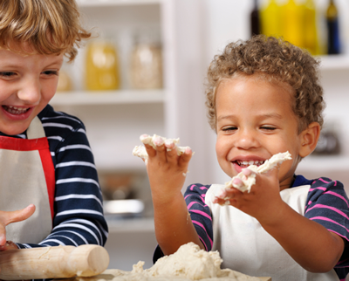
Food and Nutrition
Food and Nutrition Experiences teach:
Sensory development
Attracts the eye and satisfied the palate
Adequate nourishment by supplying valuable nutritive elements while avoiding useless calories
Ways to keep a child’s mind and fingers busy
Food preparation skills

Slide 10
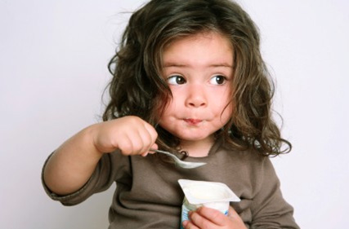
Food and Nutrition
Guidelines for facilitating appropriate Food and Nutrition Experiences
Explain steps in a short, clear, and sequential manner one task at a time
Provide pictures of the steps
Ask questions and have discussions
Let the children help

Slide 11
Food and Nutrition
What skills and curriculum areas do food experiences promote and enhance?
Critical thinking skills
Language skills
Problem solving
Promote language, math, and science concepts

