Slide 1
Utah CHILD CARE LICENSING STANDARDS

Slide 2
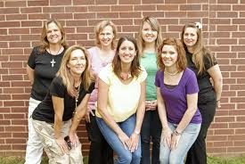
1. DIRECTOR QUALIFICATIONS
Minimum age for a director is 21 years of age.
Associates, Bachelor’s or Graduate degree
Could also have a degree in a related field with at least 4 courses taken in the Child Development area and work related experience or a nationally recognized license such as in:

Slide 3
Licenses available
CDA: Child Development Associates
480 hrs lab experience and 120 education hours with a portfolio, professional observation, family questionnaire, and an assessment.
NAC: National Administrators Credential
Developed Directors and Administrators of child care programs and is an award for demonstrated mastery of administration skills to managing a child care center.
CCP: Certified Childcare Professional
A credential earned by teachers who want to demonstrate their knowledge of early childhood development and their skills in working with young children.

Slide 4
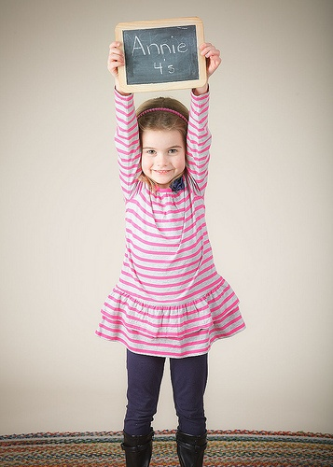
2. CDA License
CDA: Child Development Associates
120 hours in class
480 hours work experience
Compile the CDA Portfolio
Complete a parent evaluation
Have an on-site observation
Take a test

Slide 5
What is the difference between the CDA and the CCP?
In most states, the credentials are recognized as equivalent. Both credentials measure competence in teaching childhood education, however have slightly different requirements which include:
CCP 720 hrs experience and180 hrs education with a portfolio.
CCP more expensive to enroll in program and to obtain license.
CDA nationally recognized vs. CCP may not be recognized in some states.

Slide 6
1. TEACHER QUALIFICATIONS
In order to work in a licensed childcare facility as a teacher, one must be 18 years old.
20 hours of annual in-service classes are needed to keep up the teaching qualifications.
If supervised by a competent 18 year or older teacher, 16 year olds may be hired on in the center as assistant teachers.

Slide 7
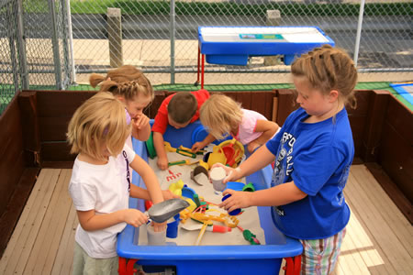
3. Quality Child Care
Program Characteristics:
Low adult-child ratio (not too many children for each adult to care for; the younger the children, the more adults will be needed.
Small group size.
A variety of activities appropriate for the age of the child.
Development encouraged in all areas of emotional, social, intellectual, language, and physical skills
Adequate amounts and arrangement of space.
Safety.
Good nutrition.
Clean environment.

Slide 8
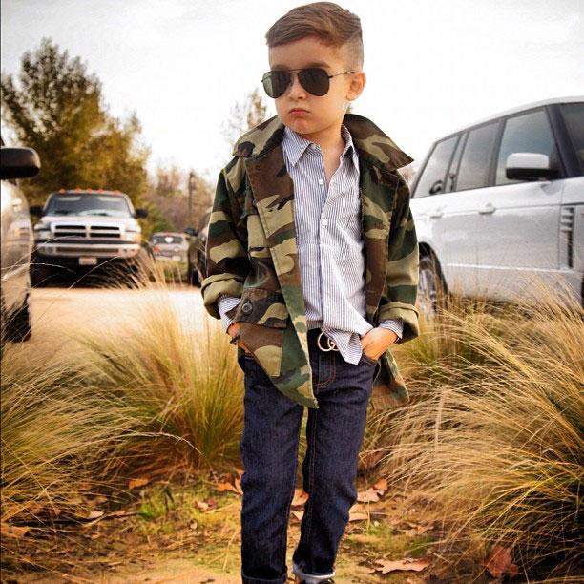
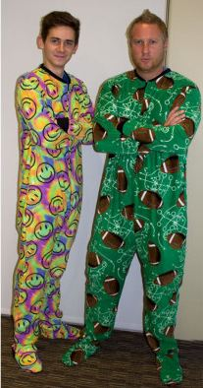
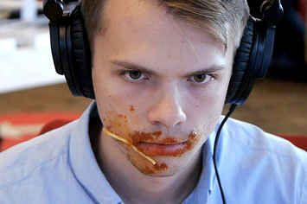
Rate Yourself…

Slide 9
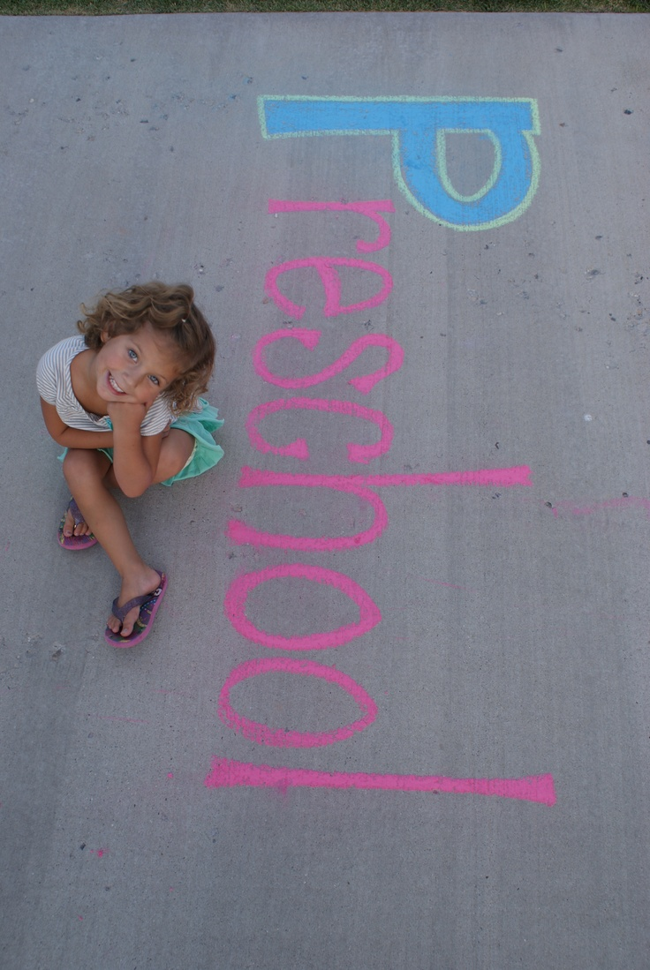
4. LICENSING LAWS
You must obtain two licenses to open a licensed childcare business for profit, taxes, and government funding.
Child Care license
Business License
***Renewed once a year.
*Childcare facilities are licensed through the Utah State Department of Health.

Slide 10
INSPECTIONS
Three inspections will be made by
a. Health Department
b. City & County
c. Fire Marshall
Name 4 things they will be inspecting for:
Neighbors, smoke alarms, fire exits, safety, outdoor equipment, clean sinks and garbage's, food handlers permits, square footage, CPR and first aid certification, etc.

Slide 11
PRESCHOOL LICENSING
Are there licensing requirements for running a PRESCHOOL in a home or building?
Not usually, unless you plan to claim it as income for tax purposes.

Slide 12
Licensing laws
Minimum Room temperature
72 degrees
Water temperature on water heater must be 110 to 120 degrees.
So the child will not be burned by the running water.

Slide 13
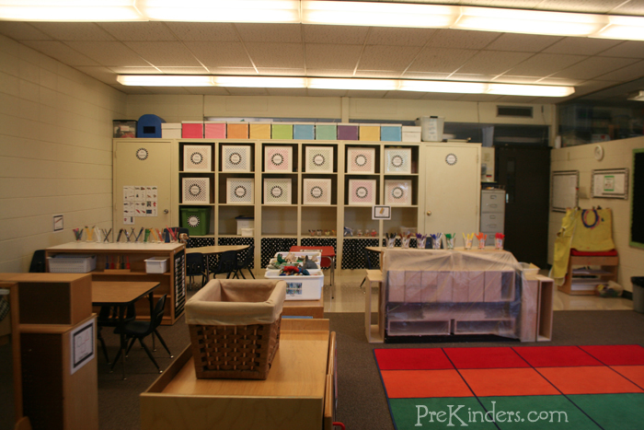
INDOOR SQUARE FOOTAGE REQUIREMENTS:
Minimum requirements for square footage in indoor play areas
35 square feet per child indoors.
Indoor play area must have supervised access to a drinking fountain.

Slide 14
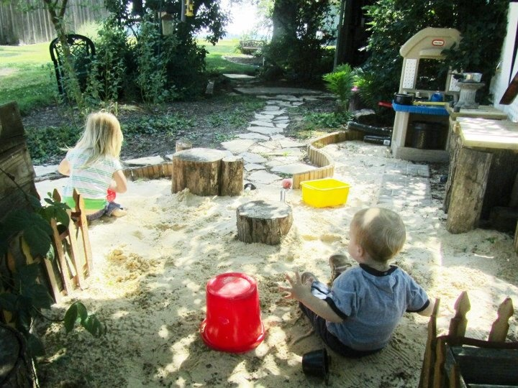
OUTDOOR SQUARE FOOTAGE REQUIREMENTS
40 square feet per child in an outdoor play area
Minimum of a total of 1000 square feet for an outdoor play area.
Outdoor play area must have a fence that is a 5 foot fence.
Outdoor play area must have shade, grass and access to a drinking fountain.

Slide 15
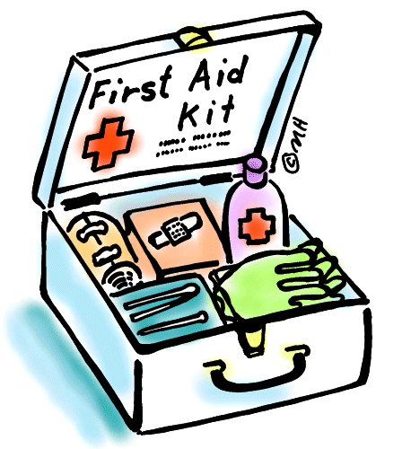
HEALTH
At all times at least one employee must be present who has CPR & First Aid.
Each employee will be screened for TB.
Each employee who handles food will need a Food Handlers Permit.

Slide 16
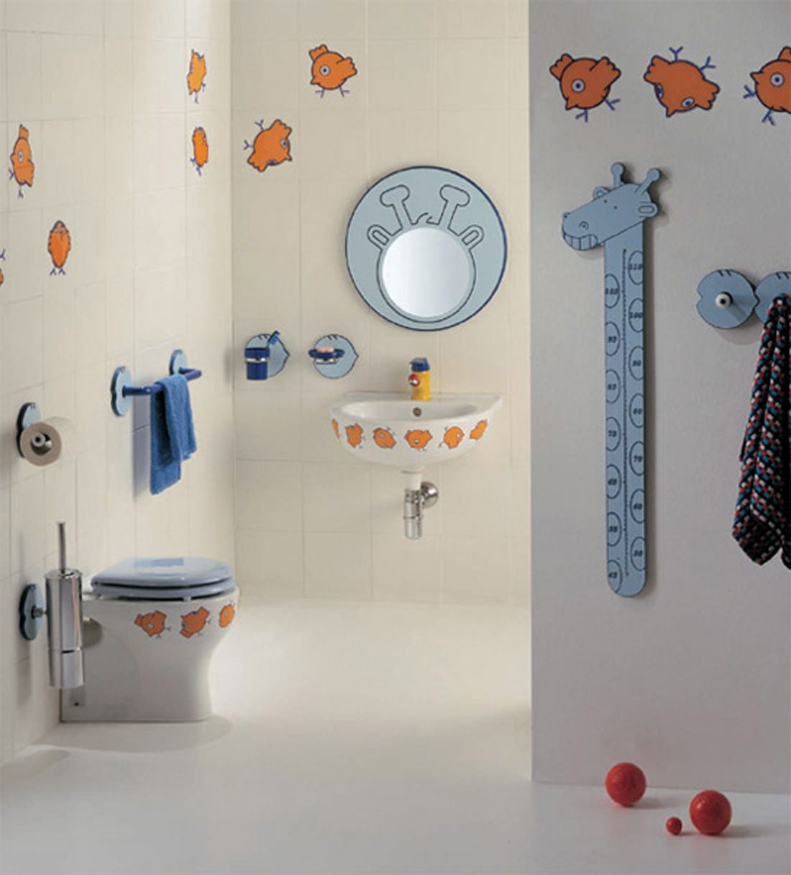
For each 15 children there must be 1 toilet and sink.
Each center is to have a working public telephone
There must be a posted evacuation plan.
NO smoking is allowed at a day care.

Slide 17
Checking children In and Out
We have a clipboard with the preschooler’s name on it
The parent will drop their child off and sign in
When the parent comes to pick up the child they will sign the child out.
This helps us to keep track of who is coming in and out of the preschool.
What if a stranger comes to pick up the child?

Slide 18
All children’s records and information are to be kept confidential and only told to those employees within the center who need to know in order to provide the best care for the child.
All children must have current and proof of immunizations.
2 child care provider rule states that two child care providers must be in the center at all times when there are two infants or when 6 children are present. NEVER just 1 on 1.

Slide 19
MINIMUM CAREGIVER/CHILD RATIOS FOR DAY CARE

Slide 20
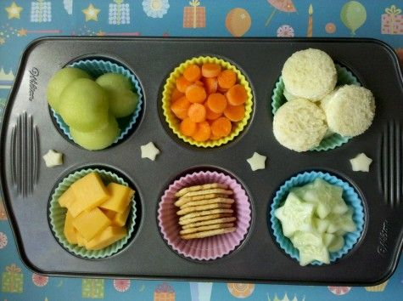
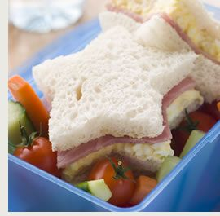
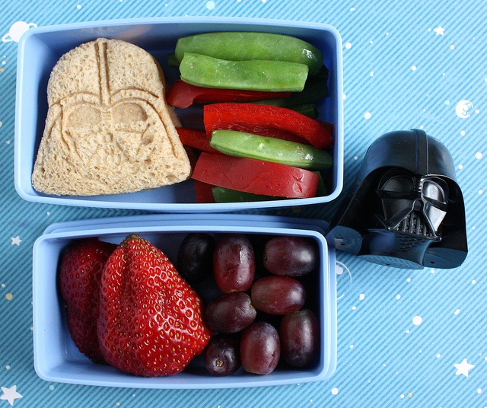
MEAL & SNACK REQUIREMENTS:
Time | Meals/Snacks
Up to 12 hours | 2 meals & 2 snacks
Up to 8 hours | 1 meal & 2 snacks or 2 meals & 1 snack
Up to 5 hours | Both a meal and snack
Less than 4 hours | 100% fruit juice or milk and a snack item

