Slide 1
Injury, Communicable Diseases, Immunizations, Safety
Standard 3 Objective 1

Slide 2
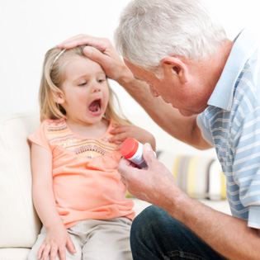
Leading Cause of Injury/Death
Accidental injury or death

Slide 3
Guidelines for a Secure and Healthy Environment
Child-friendly
Age-appropriate
Well-maintained
Clean
Promotes all areas of development
Creates spaces that are pleasing and meant for children
Access to materials and spaces where children can play safe and comfortably

Slide 4
Communicable Disease
What is it?
Examples
Disease that can be passed on to other people
Pink eye
Chicken pox
Mumps and Measles
Common cold
Flu
Hepatitis A
Influenza
Polio

Slide 5
Immunizations
What it is and Common Reactions.
Examples
Medicine given to help prevent the spreading of communicable diseases
COMMON REACTIONS:
Fever
Local Pain
Swelling
MMR
Chicken pox
Tetanus
Polio
Diphtheria

Slide 6
Immunizations in a Child Care Center
*In order for a child to attend a child care facility or enroll in school, they must have proof of IMMUNIZATIONS and a current PHYSICAL
What if a child is not up-to-date?
They need to be picked up and cannot return until their record has been updated

Slide 7
Illness and Medication
If a child is ill, remove them and have their parents come pick them up
All medication should be given by the child care director or provider trained in administration of medication (school nurse)
Need parent permission to give medicine
Children should not be given aspirin because of Reye's syndrome — a rare but potentially fatal illness

Slide 8
Safety and Sanitation
The best way to prevent diseases or the spread of germs/diseases is through safety and sanitation (wash hands)
Hands should be washed for at least 20 seconds (Alphabet song 2x or Happy Birthday song)
A child OR adult should wash their hands after restroom use, coughing, sneezing, diaper changing, meal prep
Other personal hygiene and sanitation practices: Clean clothes, sanitizing play tables, and all washable toys and materials. Stuffed animals, dress up clothes.
Older children toys are to be cleaned and sanitized weekly or however necessary

Slide 9
Safety Rules – Indoor/Outdoor
Free the walkways, so easily accessible to children
Store all toxic or hazardous materials away
Electrical outlets
Hot water should not be past 120 degrees

