Slide 1
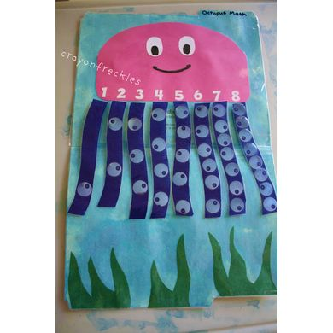
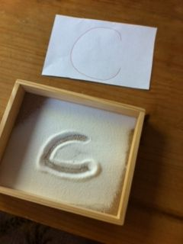
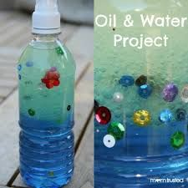
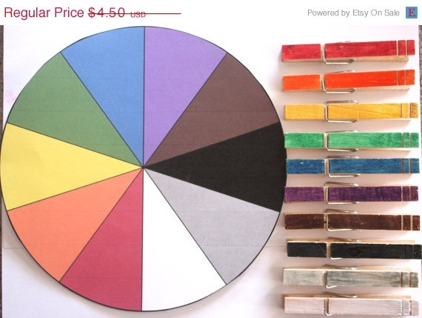
Curriculum/Lesson Planning

Slide 2
Head/Lead Teacher Role and Responsibilities
Take initial responsibility in planning
Responsible for pace of activities
Makes sure skills and resources available for activities
Helps clean up
Completes evaluation on lesson

Slide 3
Support Teacher Role and Responsibilities
Has obligation to support lead teacher
Makes suggestions at planning sessions
Fulfills assignments given by lead teacher
Works directly with children during group time and assists them
Deals with quieting a child or settling confusion
Knows finger plays and songs to assist lead teacher
Helps with clean-up and evaluation

Slide 4
Curriculum Planning
Calendaring
Daily Scheduling
Tells what themes will be assigned each day, week, or month and an idea for what will be done each day
Makes sure curriculum is completely covered
Showing which activities will be covered for the day

Slide 5
Curriculum Planning
Lesson Plans
Describes:
Activity
Learning goals/objectives
Procedures for activities
Lists needed supplies

Slide 6
Purpose of Curriculum Planning
Teacher
Parent
Knowing what to expect reduces stress for teacher and children
Plan for required materials
Following the day in an organized manner is easier and more fun
Feels more secure
Daily lesson plans should be posted
Encourages them to discuss school with their child

Slide 7
Purpose of Curriculum Planning
Child
Knows what to expect
Reduces tension and misbehavior
Sense of time and sequence developed
Learn skill of predicting (problem-solving)

Slide 8
Components of a Lesson Plan - THEMES
A main topic, ideas, or concepts around which the classroom activities are planned.
What types of topics are the most effective to use with children?
Those that address the interests and needs of the children, events occurring due to season, holiday

Slide 9
Components of a Lesson Plan - CONCEPTS
Vocabulary words, factual statements, and experiences that you want the children to understand as they complete the learning centers
States the minimum standard of achievement

Slide 10
Components of a Lesson Plan - OBJECTIVES
Describes the expected outcome or overall goal of an activity or what is to be achieved through the overall lesson and day
What is it that you hope the children will learn or take from the lessons and activities?
Provides a basis for assessment of learning
Did the child accomplish the objective? If yes, then learning occurred
There are 3 parts to the objective which include conditions of performance, the behavior, and the level of performance
The children will… VERB (NOT LEARN), …Level of performance

Slide 11
Components of a Lesson Plan - PROCEDURE
What is going to be done and how you are going to do it.
Title or name of activity
Description of the activity with an estimated time
Procedure written in enough detail that another person could facilitate the activity
Curriculum Area
Supplies needed to successfully complete the activity
***Enough detail that another person could teach the lesson for you!

Slide 12
Components of a Lesson Plan – CURRICULUM AREA
Fine and gross motor activities in the areas of math, creative art, science and discovery, language and literacy, and music and movement

Slide 13
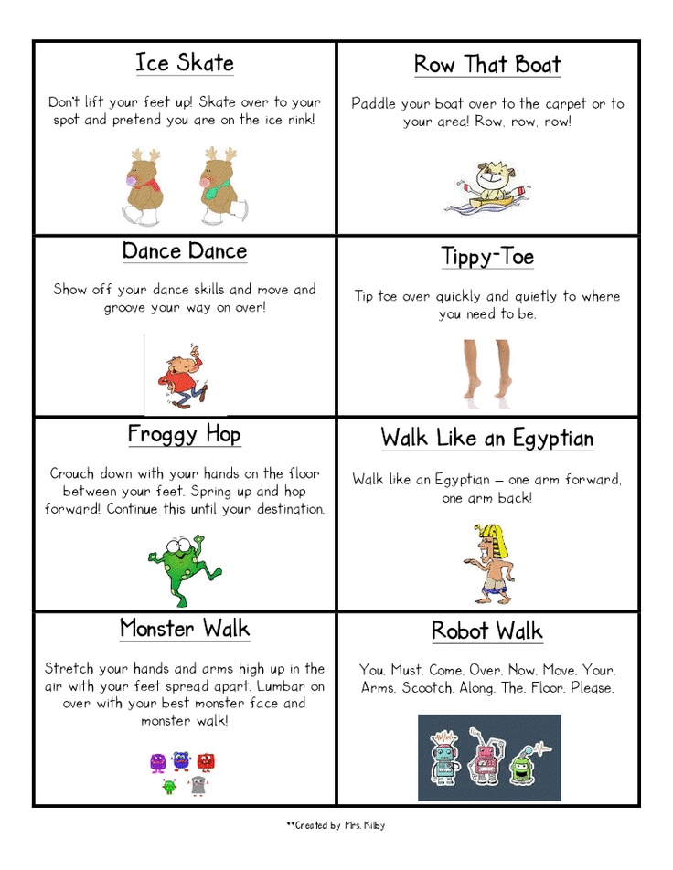
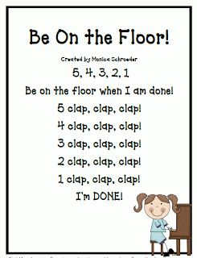
Components of a Lesson Plan - TRANSITIONS
Refers to the movement from one activity to another or the beginning of an activity so as to begin a new activity
EX: “If you can hear me touch…”

