Slide 1
CENTERS 2 Continued…

Slide 2
Creative Arts
What does art do for children?
A means to express self-interest, perceptions, feelings, and style.
Art can give clues as to how a child is feeling.
Encourages complex thinking by allowing the child to focus on creating their own ideas.
Shows the uniqueness of child’s identity.
Children are not yet under the constraints of realism.
They feel free to represent in their art what matters to them.
Develops positive self-concept and a sense of accomplishment.
What if they ask you to do the project for them?
Visual thinking tracks growth in areas of development like physical and cognitive (intellectual) development.
Develops fine motor skills and hand-eye coordination.
Shows their interpretation of their world that they live in.

Slide 3
Creative Arts
Setting up the art center:
Organization of the area affects the kids ability for inspiration, creativity, and self-expression.
Shelves with clear containers.
Away from traffic and activity.
Near a sink or water source.
Provide a place to display the children’s work!

Slide 4
Guidelines for teaching ART!
#1: Children do their own work so RELAX THE CONTROLS
Let them do it on their own – use their creativity
#2: Tolerate differences
#3: Respond to their work
#4: Inspire perseverance
Encourage them to see their project to the end
#5: Art is open ended
AKA – art can be ANYTHING

Slide 5
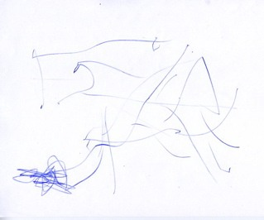
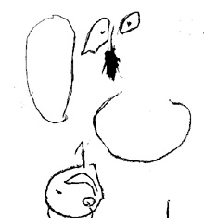
Creative Art – Stages of Art
Scribbling
Pre-schematic
1 ½ -3 years old using random experimental marks like zig-zags, scribbling, and 3 shapes
3-4 years old try to represent objects seen in the environment, colors are not realistic, can draw shapes, and they use their time to create pictures
The circle is the most favorite and recognizable shape

Slide 6
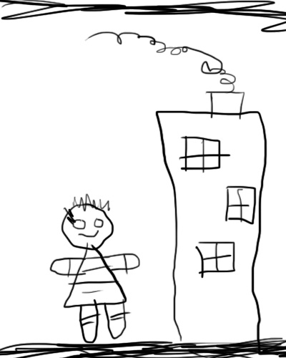
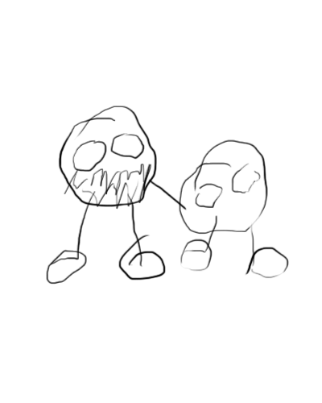
Creative Art
Schematic
Realism
4-5 years old begin to draw people their way (people with no necks)
Uses circles to represent face with the arms and legs coming out of the face
Add basic body features: hair, hands, feet. Self-portrait is typical
5-6 years old interested in art that looks real. Noticeable differences in drawings between boys and girls.

Slide 7
Science and Sensory
Science and Sensory Activities include:
Simple experiments
Predictions
Hands-on learning experiences
Using the senses to explore
Observations
Compare and classify
Exciting discussions that build language skills and encourages curiosity
Effective questioning to encourage critical thinking skills and problem solving to make all of the above happen

Slide 8
Science and Sensory
Questioning
Ineffective: closed-ended questions
Effective: open-ended questions
Sensory tables:
Anything that provides children with an opportunity to explore using their senses.
A sensory table is more than just sand and water: wheat, straws, snow, mud, rice, etc. They also contain equipment for exploring like water wheels, funnels, plastic beakers, cups etc.
Children should wash their hands before participating in a sensory activity.

Slide 9
Science and Sensory
Setting up the science area
Outside or Place it near a window. Place it on tile and in a wet area. Place it away from active play.
Include a variety of materials for the child to actively examine, explore, and experience using all of their senses.
Include a sensory table. Anything that provides children with an opportunity to explore using their senses. A sensory table is more than just sand and water: wheat, straws, snow, mud, rice, ooblek, etc. Contain water wheels, funnels, plastic beakers, cups etc

Slide 10
Science and Sensory
Areas of science include:
Chemistry: suspension, chemical reaction, chemical change
Physics: balance, weight, movement, gravity, magnets
Astrology / meteorology: solar system, light and dark, weather
Biology: living and non-living, animals, habitats and diet, “You” – human body
Botany: plants, germination, photosynthesis, purpose of plants
Ecology: conservation, recycling, erosion, care of the environment, rocks

Slide 11
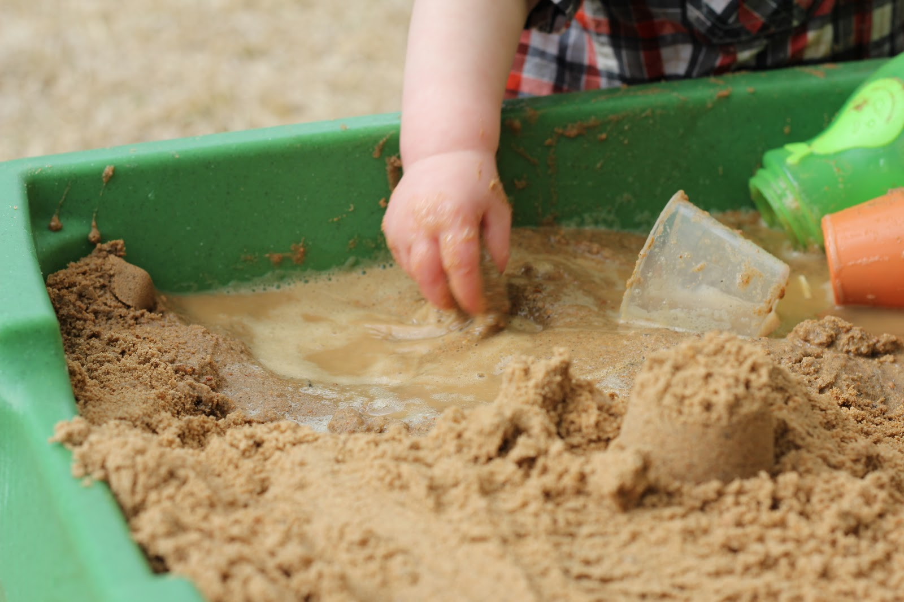
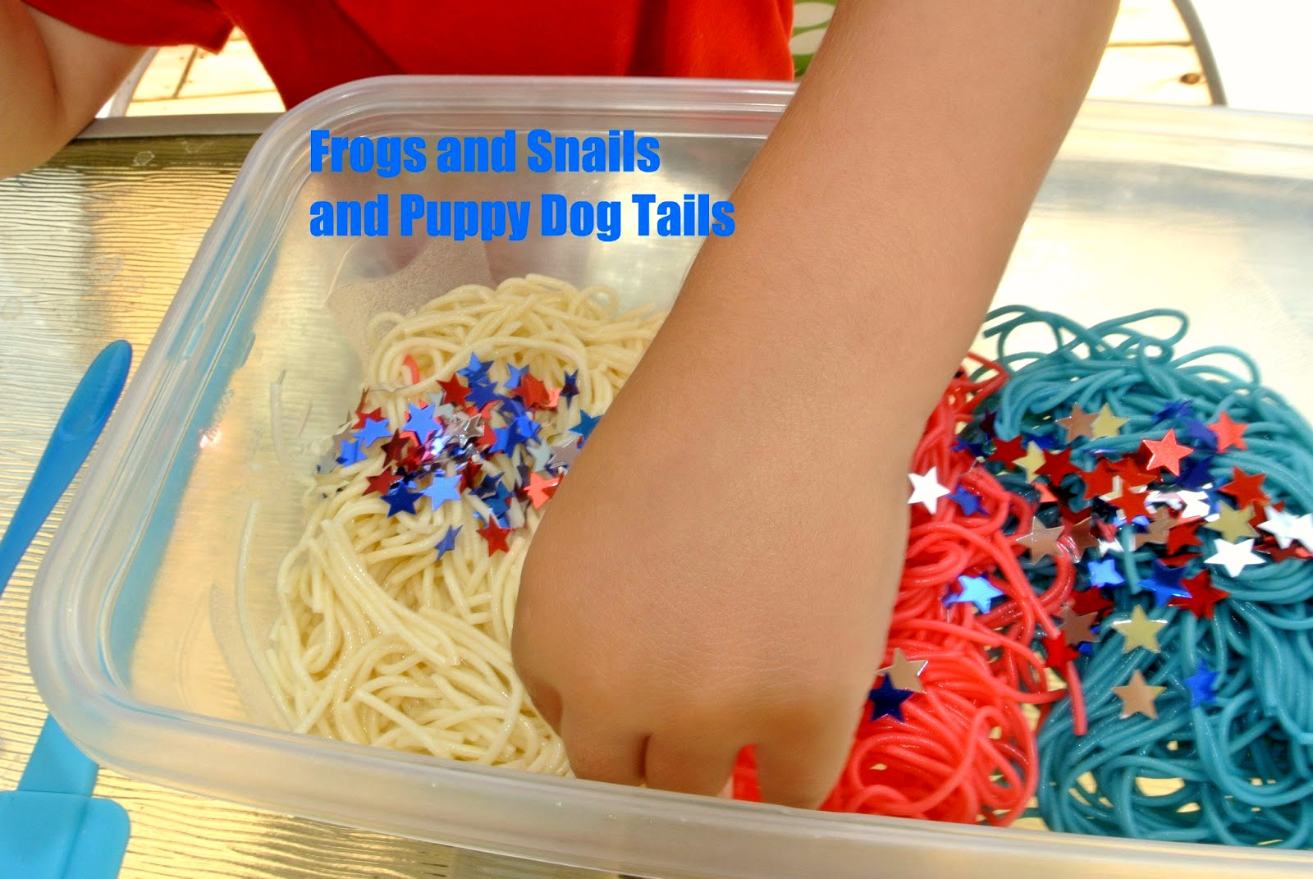
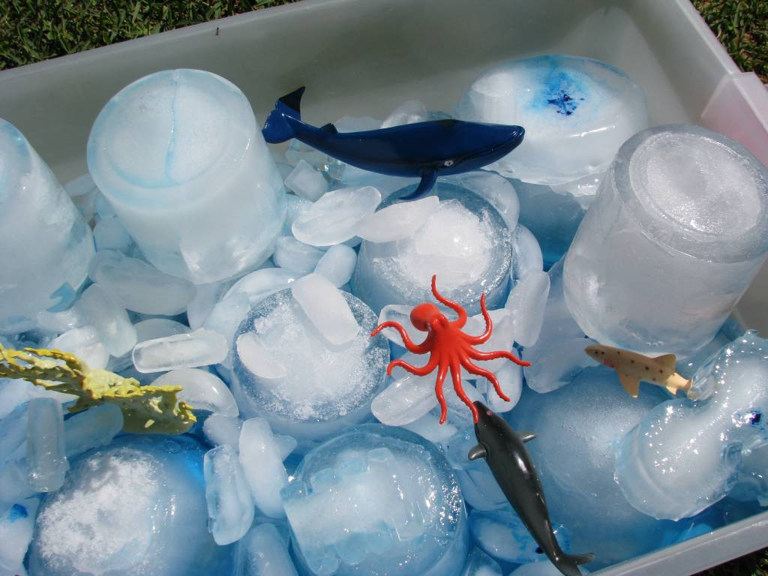
Science and Sensory
The purpose of the science and sensory activity is:
An opportunity to explore using their senses
Ice and Water
Sand
Noodles

