Slide 1
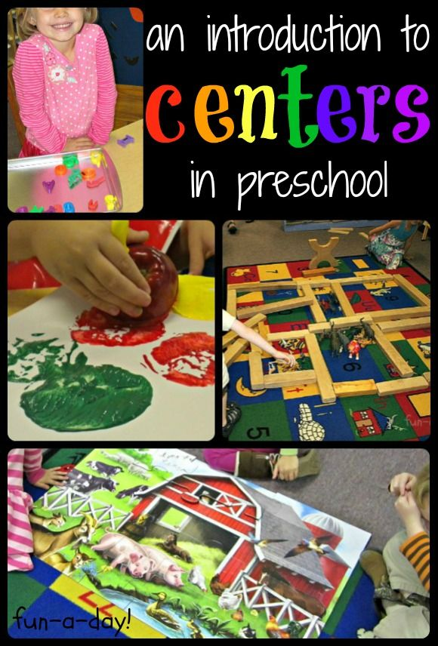
CENTERS

Slide 2
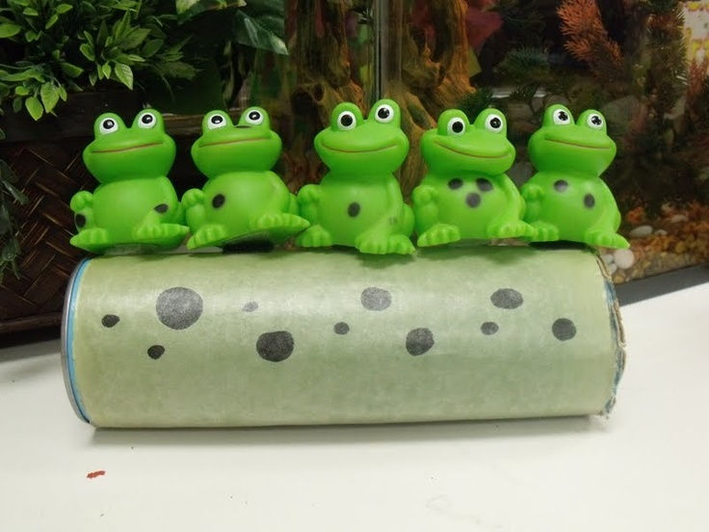
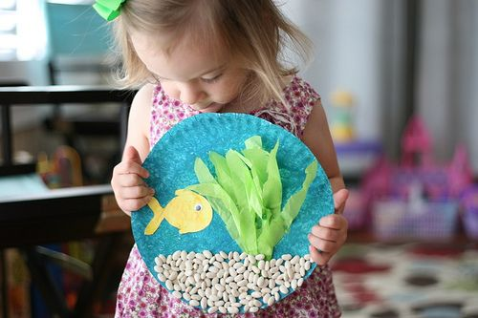
Language and Literacy
What activities fall under language and literacy?
finger plays, stories, show and tell, letter and sound recognition

Slide 3
Language and Literacy
What might you look for when choosing an appropriate story for a preschooler?
Anything that will help to promote the development of language and the letter & sound recognition for young children.
Consider:
the amount of words on the page
the vocabulary level
the illustrations
the amount of pages
the topic
AND – is it relevant to the child.

Slide 4
Language and Literacy
Show and tell (aka Sharing Bag)
Helps improve child’s language skills
Helps with ability to listen
Helps with ability to speak in front of a group
Play
Engaged in conversations, questioning, and discussions\
Not quiet
Finger Plays
Help with language and fine motor skills
Help with memory and speaking skills

Slide 5
Language and Literacy
How can it be handled when a 3 year old becomes distracted and noisy during story time?
Consider their attention span by picking easier and shorter stories to read to the group

Slide 6
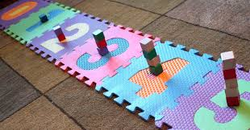
Math
What activities or skills fall under math?
Counting, Measuring, Classification and Sorting, Statistics & Probability, Sequencing, Time, Spatial Relations, Temperature, Shapes, Patterning, Color, Seriating, Money
#1: Counting, “One to One”:
Slowly touching each object one at a time and setting it aside as they count.

Slide 7
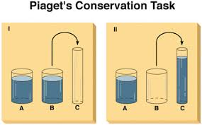
Math
#2: Measuring
Figuring the measurement of objects in length, height, weight, size, using their hand, their pencil, candy in a line, etc…
Law of Conservation
Even though an objects shape changes, its volume or amount stays the same!

Slide 8
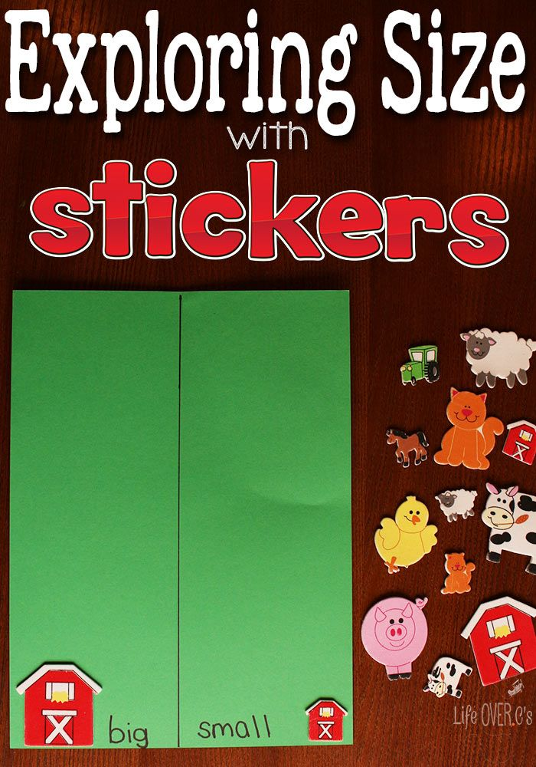
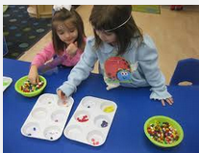
Math
#3: CLASSIFICATION
Categorizing or putting items together that are alike in some way or that belong together and share similar qualities
EX: categorize by nature, family, name, etc…
#3: SORTING
Colors of dogs, size of the dogs, etc.
Sorting trays help organize such as:
Muffin tin, ice cube tray, egg carton

Slide 9
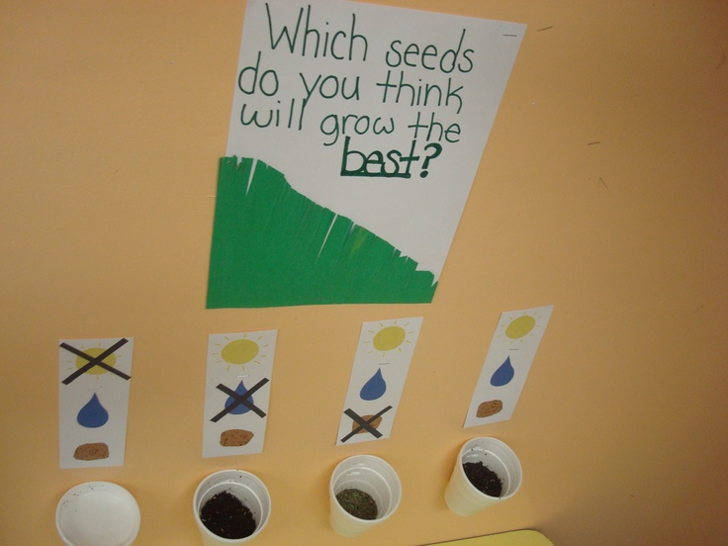
Math
#4: Statistics & Probability
Creating a visual representation of your discovery. Graph types of bugs found, growth of plants, hair or eye colors in class, etc.
Making a prediction. Predict how many flowers will bloom from seeds planted.

Slide 10
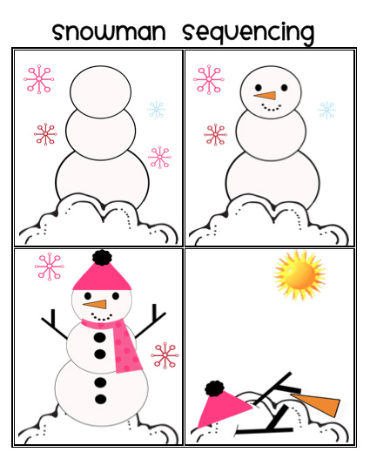
Math
#5: Sequencing
The order of how to accomplish a task or how things happened.
Vocabulary words: Beginning, middle, last, end,1st, 2nd, 3rd, etc.

Slide 11
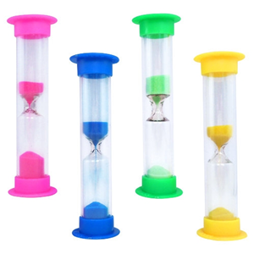
Math
#6: Time
Time concepts must relate to their world .
(Example: The length of their favorite TV show, how many “sleeps” until the child will leave on the vacation, etc.)
Vocabulary words: Before and after, sequence, timers
(Salt / Water/ Sand Timer)
Can begin to recognize numbers on a clock but the time amount is an abstract concept.

Slide 12
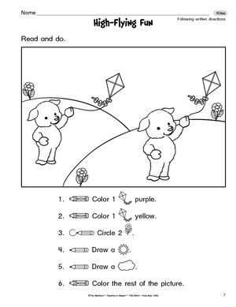
Math
#7: Spatial Relations
Maps (Map of the classroom, their house, room, etc.)
Space / matter (vocabulary: On, in, under, next to – Place the dog in a dog house. On top of the dog house. Under…)
Building with blocks or creating sculptures.
Following directions (Draw a red flower next to the orange flower.)

Slide 13
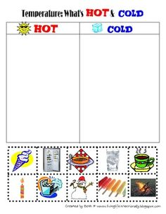
Math
#8: Temperature
Using the senses to understand the difference between hot and cold.
Placing a thermometer in the shade and placing one in the car or on the slide.
Watching ice melt on the cement.

Slide 14
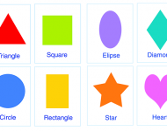
Math
#9: Shapes
Shape identification of both 2 & 3 dimension
Spheres, cubes, rectangular, prisms, cylinder (use correct names)
Pictures of shapes need name written on it (language development)
The shape of objects in a room

Slide 15
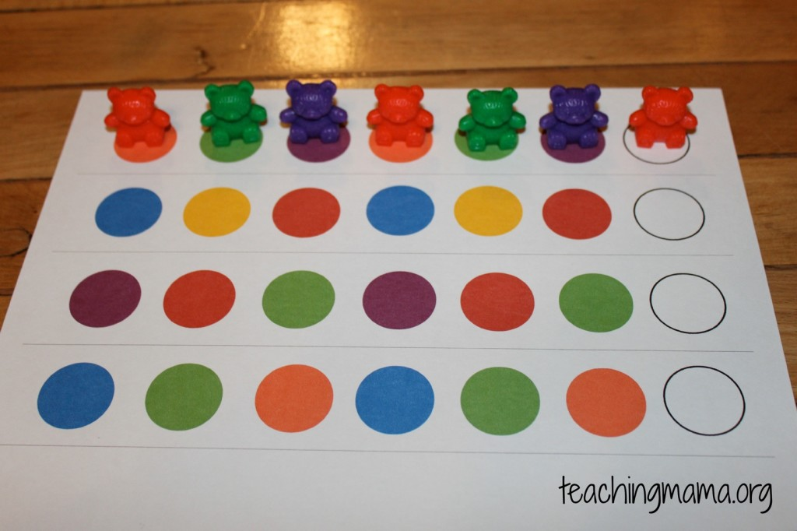
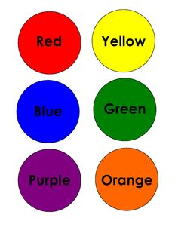
Math
#10: Patterning
Repeat & growing patterns or Eliminate ones that are different
Logical reasoning
#11: Color
Using the senses to understand and identifying the names of colors.

Slide 16
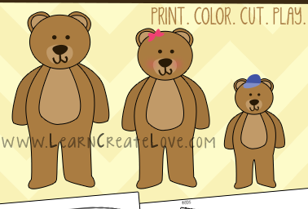
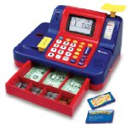
Math
#12: Seriating
Putting things in descending or ascending order based on Size, weight, and volume
Vocabulary words: big, bigger, biggest, Tallest to shortest, Lightest to heaviest
#13: Money
Children can understand that money is needed to buy items as they play activities like grocery store or restaurant.
Can start to identify coins, but their monetary amount is an abstract concept.

Slide 17
Creative Art
Use the circles to create different pictures…

Slide 18
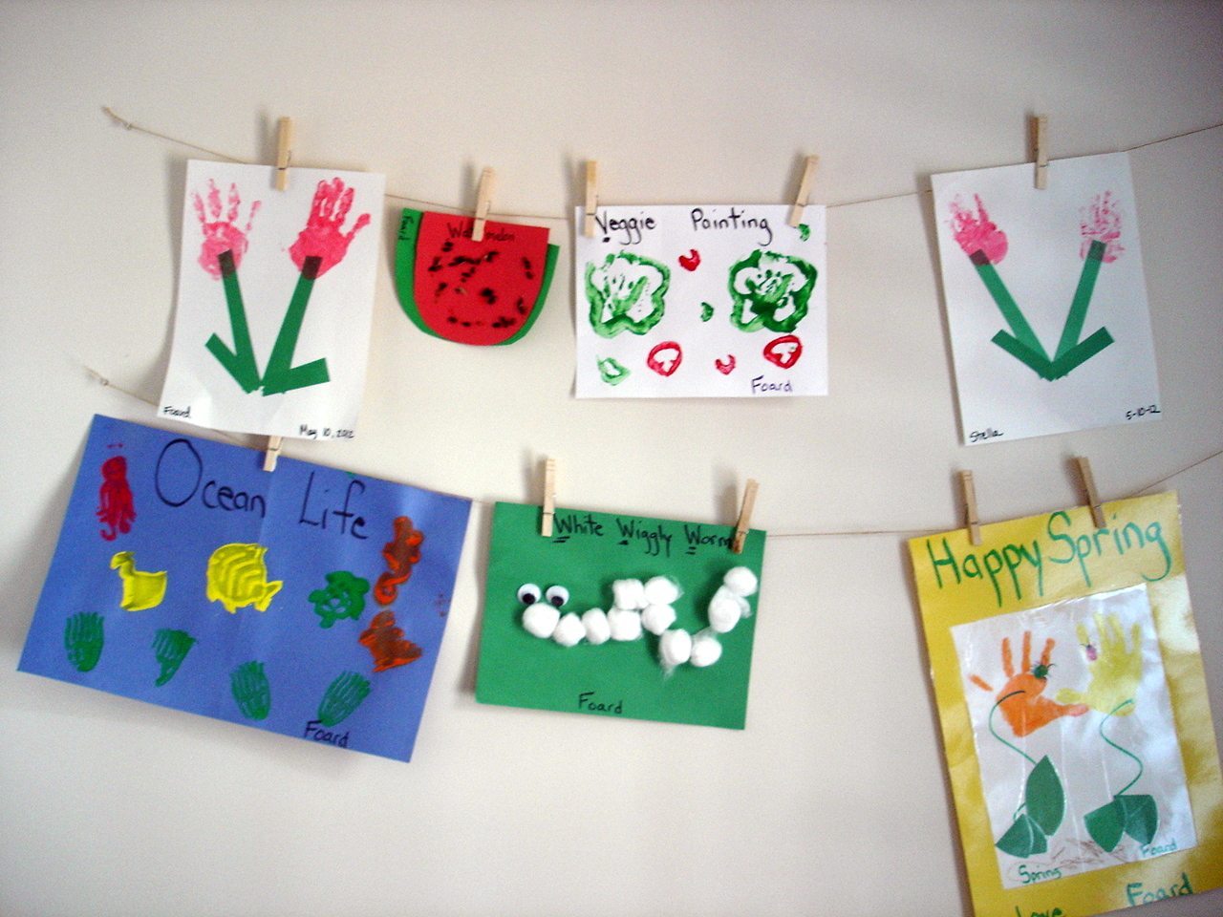
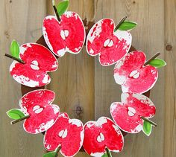
Creative Art
Creative Art is the act of putting something together in a new and different way.
Purpose:
Provides an opportunity for children to explore art media with no product goal or samples of what the product is to look like when it is finished.
Child-Directed and Child-Initiated (Create a turkey out of these materials)
Crafts are Teacher-directed
Require that children reproduce something similar/exactly the same as what they have seen.

Slide 19
Creative Arts – What is Creativity?
Elaboration: Ability to expand on ideas.
(Example: “What if dogs could talk or fish could fly?”)
Originality: Ability to create unique, clever responses.
(Example: Invent an interesting way to keep a cobweb collection.)
Problem Solving: Ability to sense solutions and problems.
(Example: You don’t have a paint brush, but you have paint.)
Fluency: The ability to produce numerous ideas, word, symbols and relationships.
(Examples: Make a list of sticky things to eat. List how you would get to school without getting wet in the rain without an umbrella?)

